Slide 1
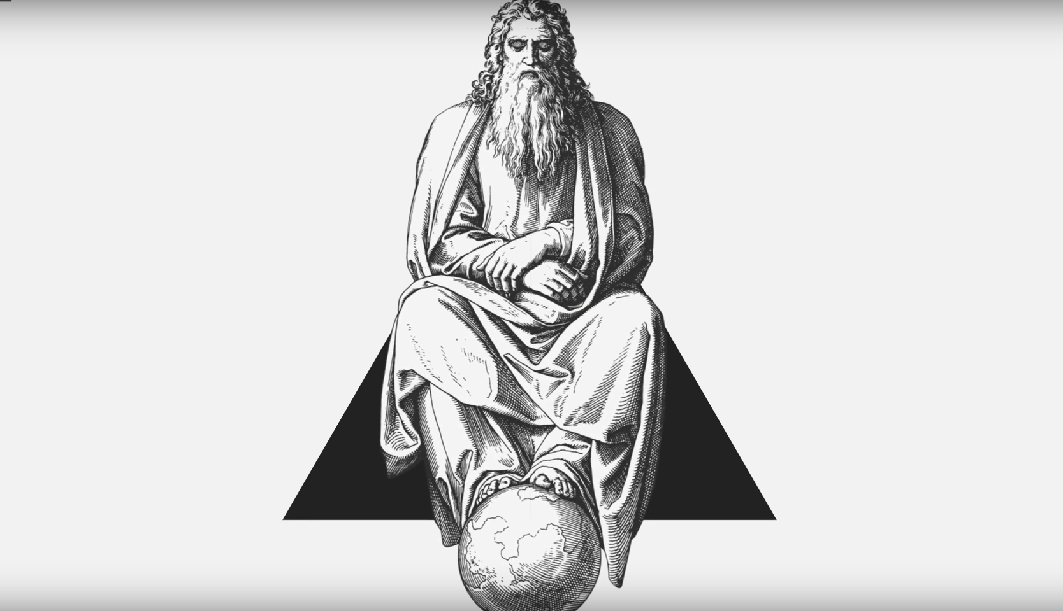
Textual
and
Sentiment
Analysis
of aspects of Divinity
B.Tech Project
Student:
Khalid Mehtab Khan
17ucs078
Supervisor : Dr. Payel Pal
Co-Supervisor : Dr. Vikas Bajpai

Slide 2
Index
Introduction
Theory Of Evolution by Charles Darwin
Textual Analysis of Religious Texts 1) The Holy Bible 2) The Holy Quran 3) RigVeda
Sentiment Analysis 1) Theory of Evolution by Charles Darwin 2) The Holy BIBLE 3) The Holy QURAN 4) GOD : A Human History by Reza Aslan
Present Findings

Slide 3
Objective:
Look for findings in Divinity, answers for all the whys’ in the human mind and science, proposes answers for the what behind these questions.
To understand things in a better way we will have to go back in time to the start, to the origin of man where things started, may it be god or may it be the science and have a textual analysis of the preserved texts which has been passed on for generations as a proof justifying both the sides of nature, the spiritual as well as the scientific.
After the text analysis, using the computations and analysis of textual data using sentiment analysis tools of python we will try to observe similarities and differences between both these sides and also differences among different angles given in the same sides. We will also try to analyse the emotions which one embibe from these texts and towards the end, the social aspects of different outcomes of the research.

Slide 4
Introduction:
Human minds have evolved by adapting environmental changes in history. However, these cognitive adaptations have, as a by-product, made humans prone to the idea of supernatural events. Evolution throughout all these years has developed a sense of hypersensitivity in humans because failing to notice potentially dangerous agents in our ancestral environment was costlier than making false alarms and our mental systems evolved to be titled towards over perception. But the by-product of being adaptively tuned to overperceive an event is that humans are biased toward perceiving agents such as gods behind natural phenomena.
This hypersensitive mental system describes biases for over-perceiving human-relevant purposes behind events and objects -adaptive because of the necessity of deciphering intentionality and the usefulness of understanding tools but leading in turn to a tendency to make attributions of divine purpose.
Belief in God: Why People Believe,and Why They Don’t
Brett Mercier, Stephanie R. Kramer, and Azim F. Shariff
Department of Psychology and Social Behavior, University of California, Irvine, and Department of Psychology,University of Oregon

Slide 5
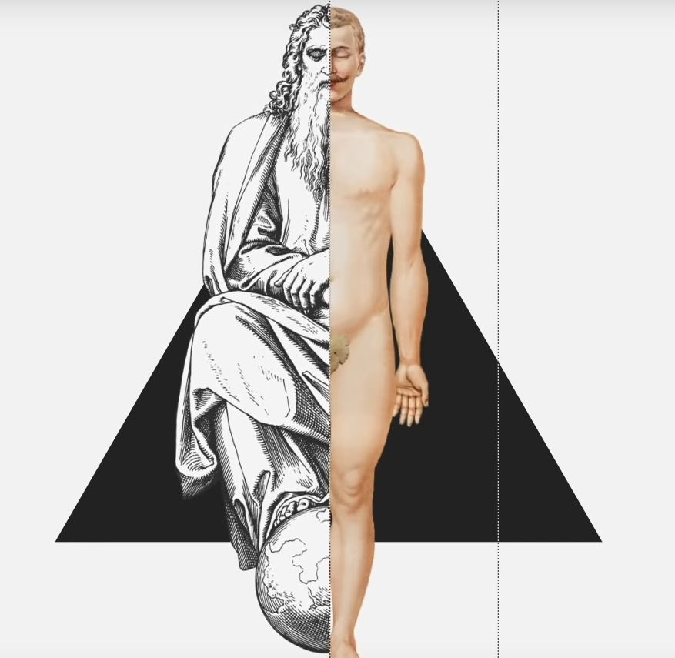
Answer to Whys’:
The entire history of human spirituality can be
viewed as one long, interconnected, ever-evolving, and
remarkably cohesive effort to make sense of the divine by
giving it our emotions and our personalities, by ascribing
to it our traits and our desires, by providing it with our
strengths and our weaknesses, even our own bodies in
short,by making God us.
What is man? “What is man that you take thought of him, And the son of man that You care for him?”. Throughout history mankind has adopted a distorted view on the nature and the character of God. In the words of Jean-Jacques Rousseau, “God created man in his own image. And man, being a gentleman, returned the favor.”
1)God: A Human History
Book by Reza Aslan
2)THE IMAGE OF GOD
A RESEARCH PAPER IDENTIFYING AND DETAILING
THE FORM, CONTENT AND FUNCTION OF
THE IMAGE OF GOD IN WHICH
MAN WAS MADE.
F16 TH201: BIBLICAL DOCTRINES
BY
THOMAS ALBERT KILIAN III
ELIZABETH CITY, NORTH CAROLINA
DECEMBER 8, 2016

Slide 6
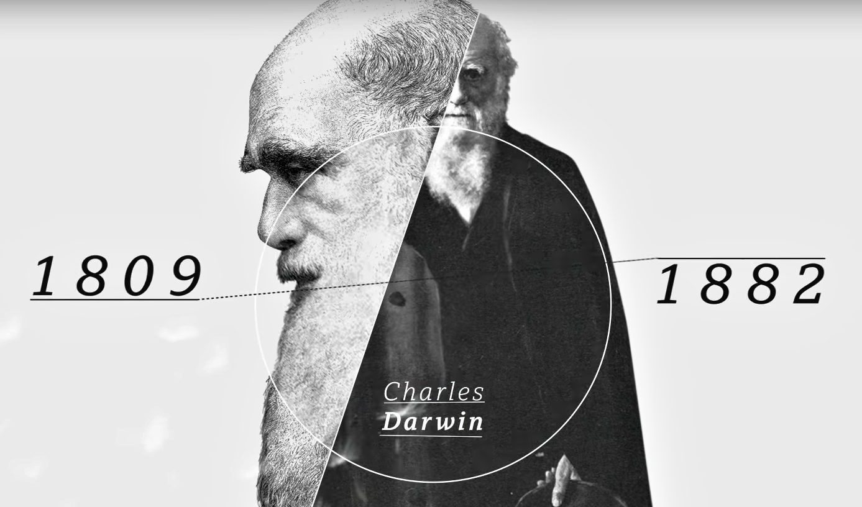
How the Theory of Evolution came into existence
How Humanity came into existence
Origin Of Species

Slide 7
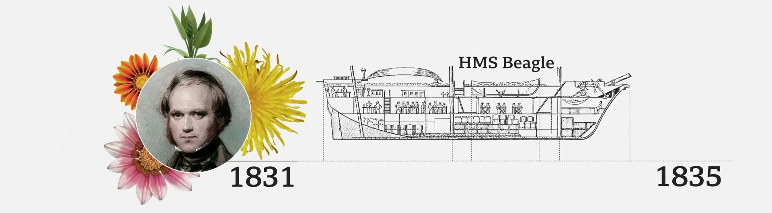
The belief that God had created mankind in his own image and likeness were shed by a most western scientist until the middle of the 19th century they thought all the creatures of the planet were conceived by a divine force that is until Charles Darwin arrived.
In 1831 Darwin was 22 years old and studying at the University of Cambridge when he was invited as a naturalist to a great expedition he boarded the ‘HMS BEAGLE’ and spent almost 5 years travelling several continents starting in South America from which he bought back dozens of life specimens, illustrations and fossils.

Slide 8
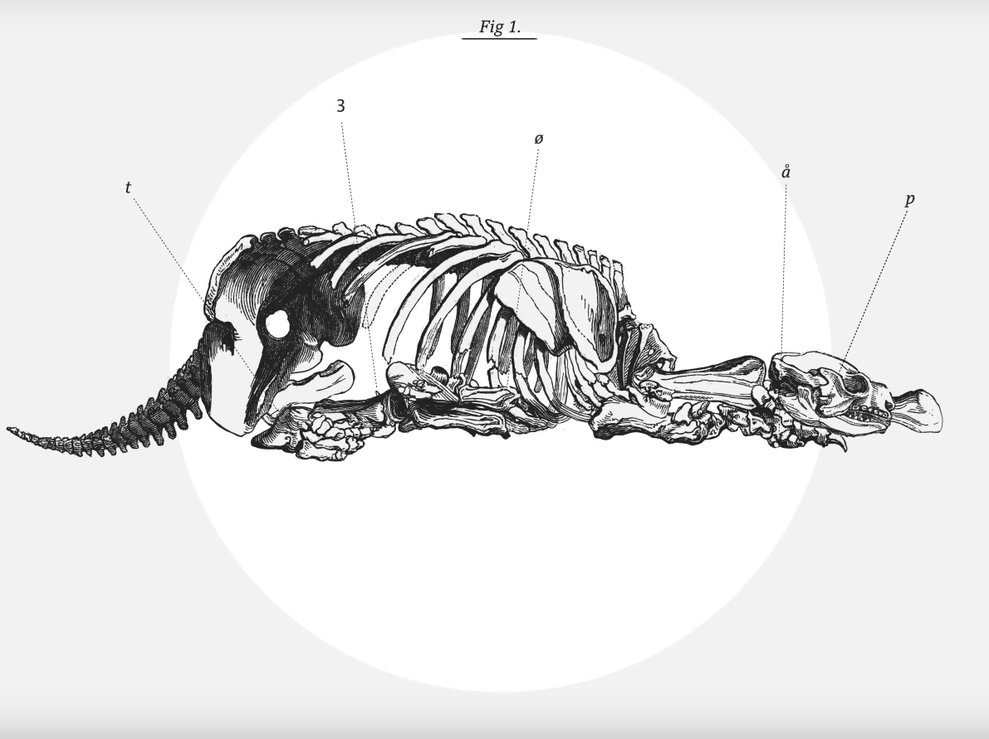
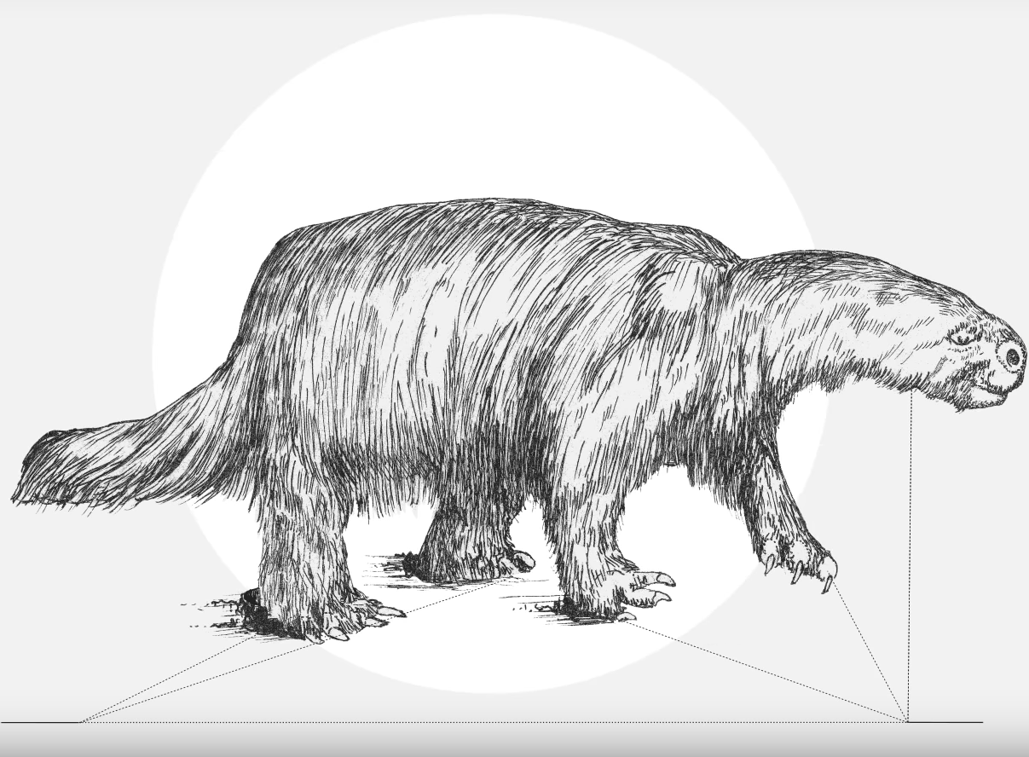
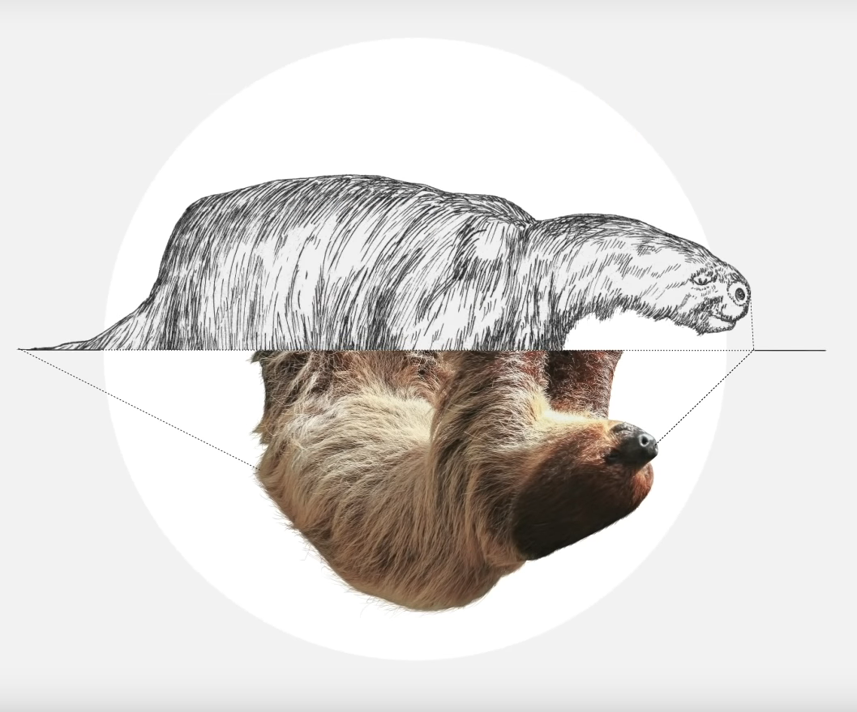
These fossils gave him one of the first clues about evolution, for example observing the remains of MILODON, a giant animal similar to the sloth he thought that these similarities were probably not a coincidence there had to be some kind of link.

Slide 9
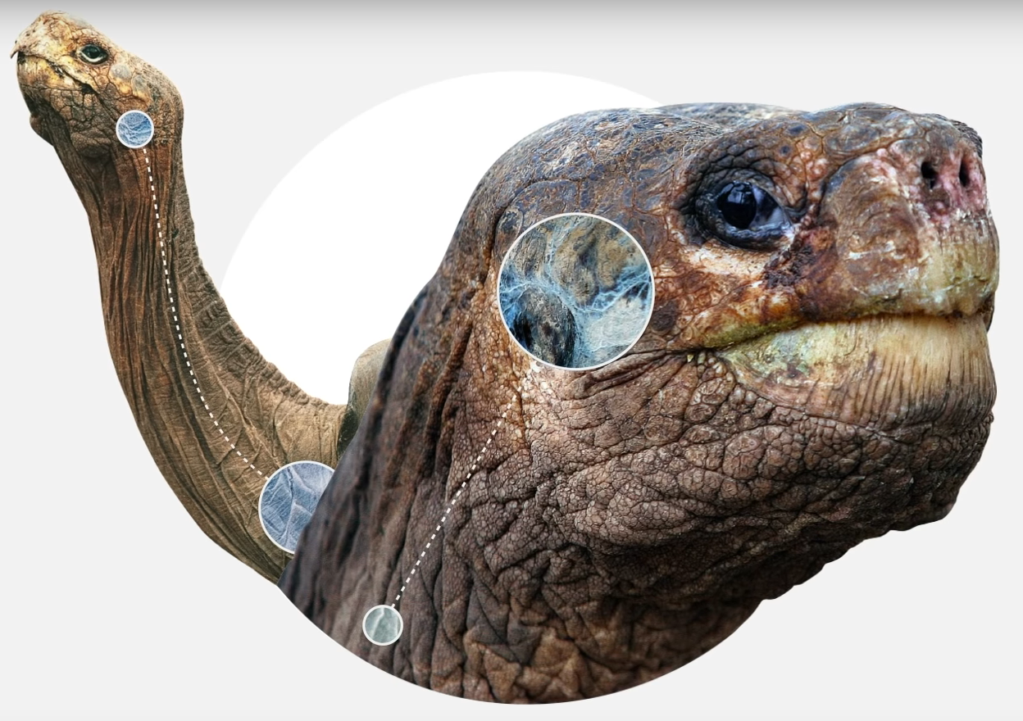
When he stopped at the Galapagos islands darwin also observed this giant tortoise which lived in the nearby island with unique physical characteristics in each island. In the humid area where vegetation was abundant, the turtles had a short neck and dome shaped shell while some island with the drier environment they had this saddle-like shell and a longer neck but could he explain that difference.

Slide 10
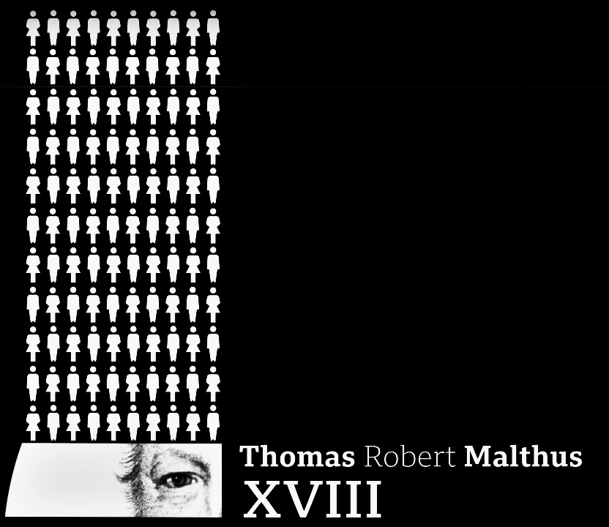
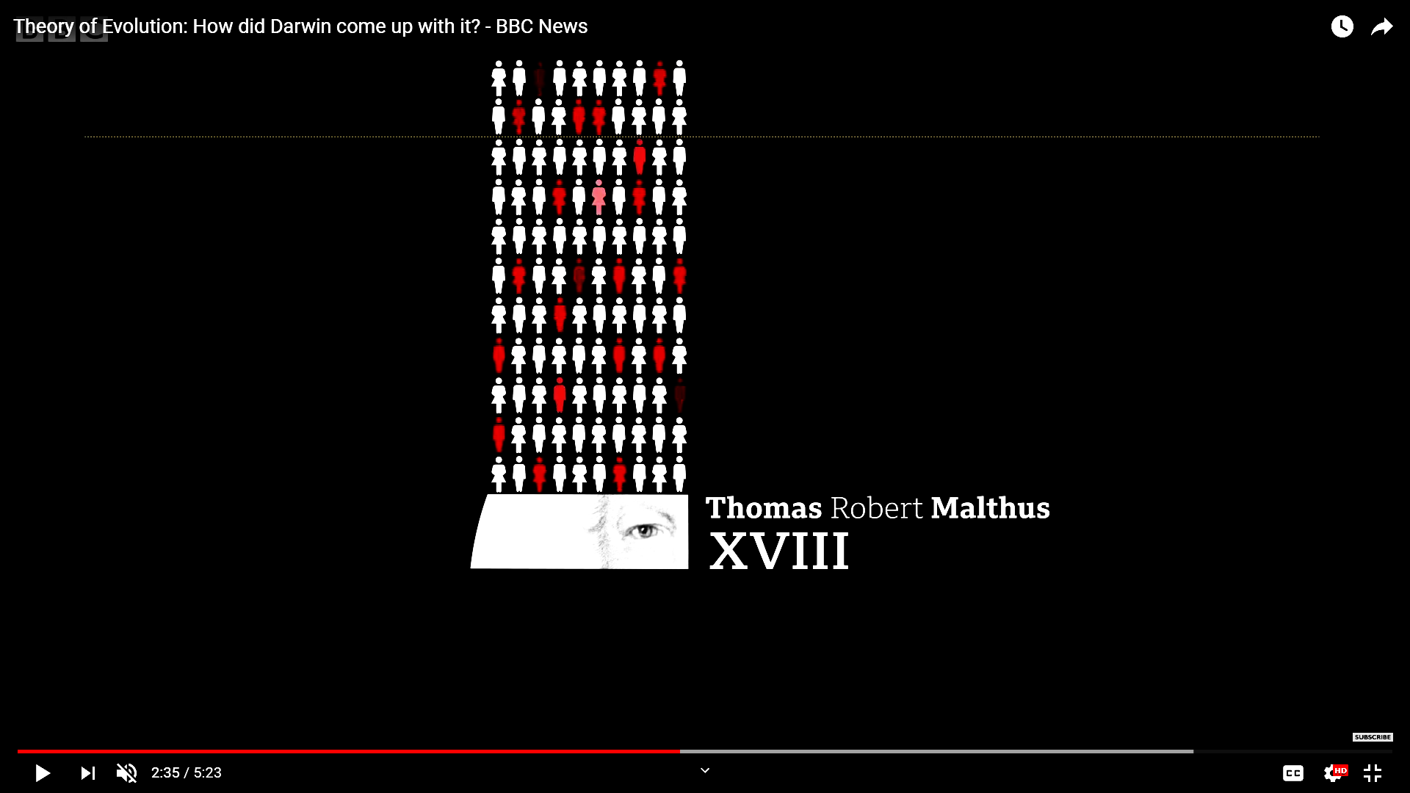
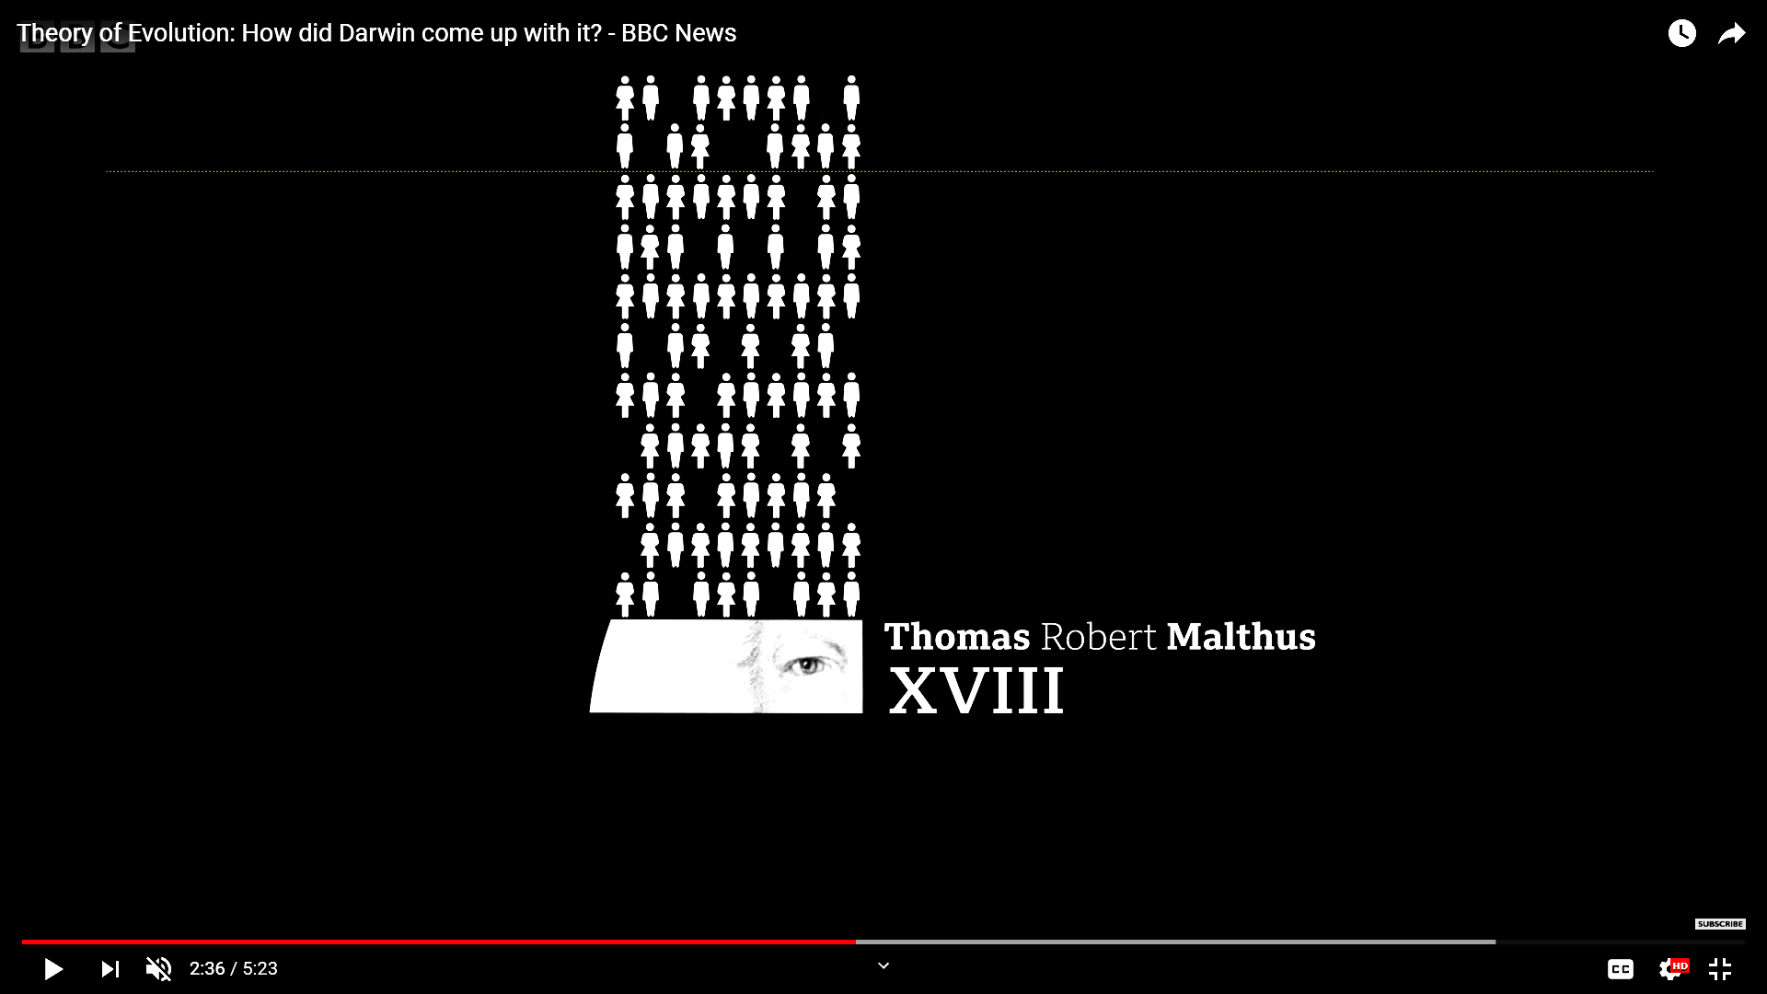
Upon his return, Darwin spent time observing how animal breeders and guarders crossbred animals of species to create new varieties, for that creation to be successful the artificial selection made by man was key. Darwin realised that the natural world probably made the same kind of selection but he couldn’t explain how it happened until he read the work of Thomas Robert Malthus a British intellectual from the ancient century.
In an essay on demography, Malthus said that as the population Europe was growing and at one point it will increase much more than the food supplies available and that would cause a fight for survival.This was the idea how Darwin explained how evolution works, in nature, there is struggle for survival in which the strongest individual, not necessarily the survivor it is the one which first adapt to the environment lives.

Slide 11
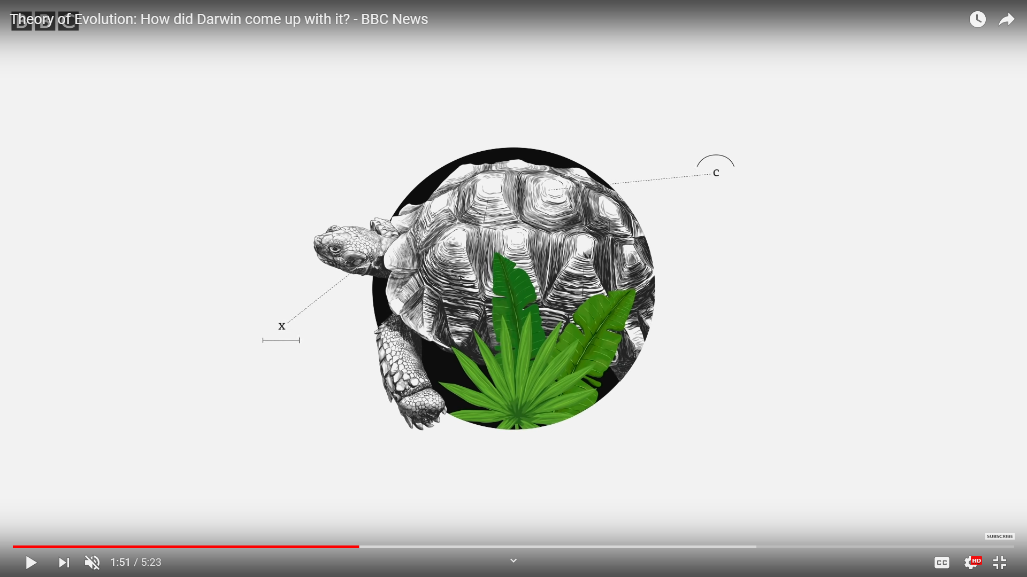
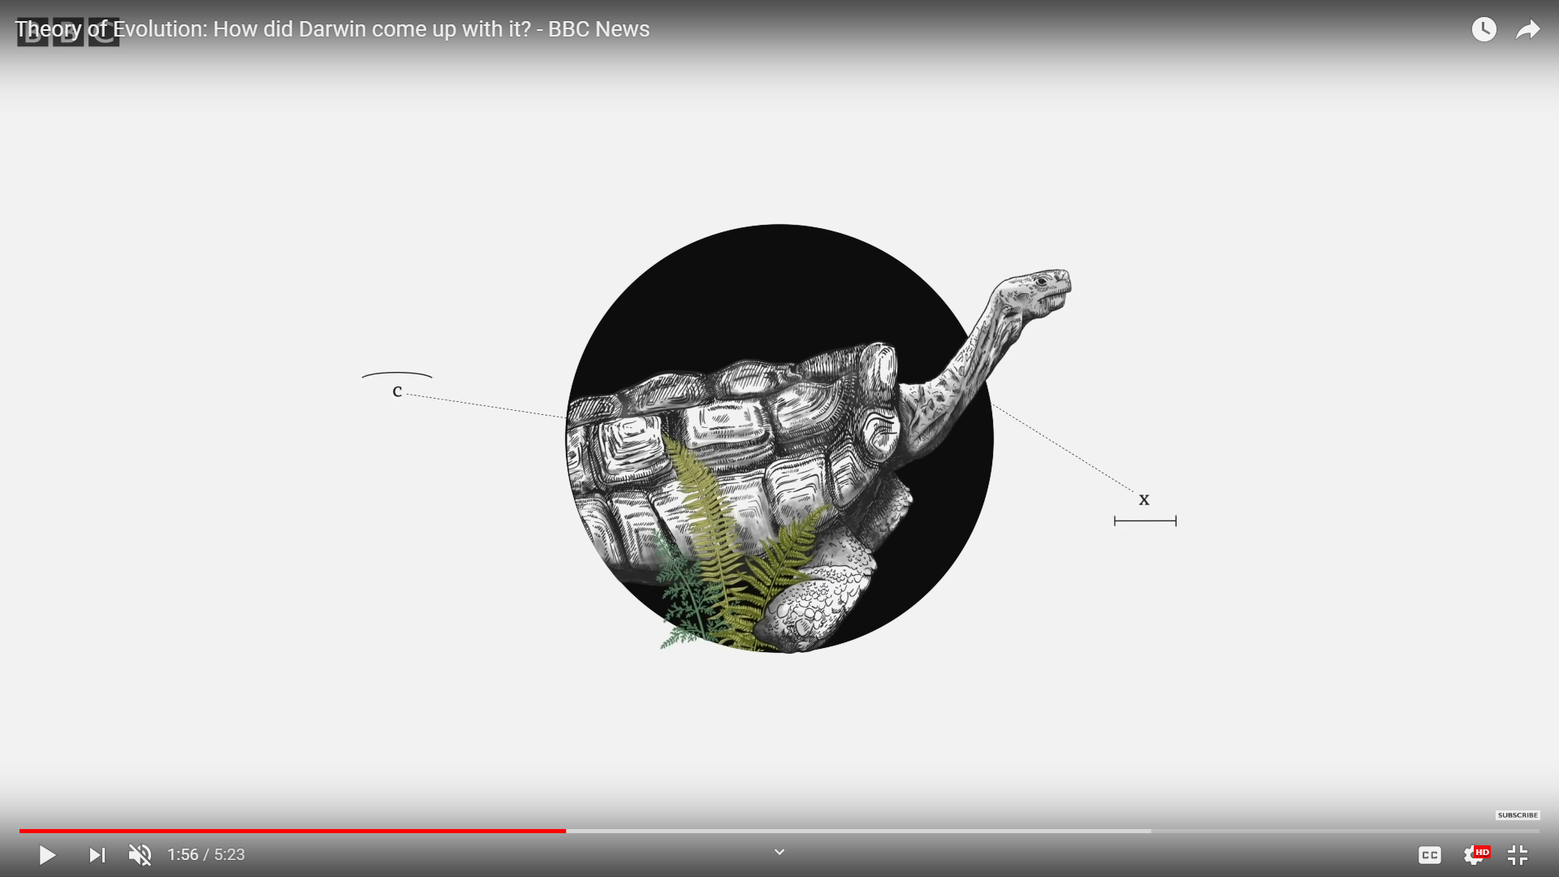
If the living being has any trait that helps him to survive it will be more successful at reproduction, those which don’t adapt will die without descending. The creatures with the most success in reproducing pass their traits - their lineage and so on until these variations end up becoming anew species that was the differences the Galapagos tortoises were the product of evolution in a drier environment those with longer neck could reach the bushes easily in order to get food while those who live in the humid environment could eat crops and protect themselves from predators thanks to their shorter and a dumb shaped shell.

Slide 12
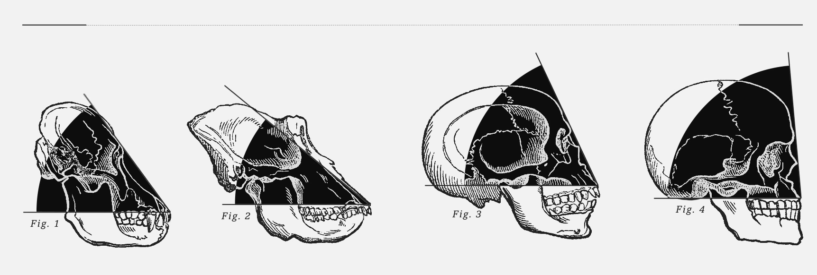
According to Darwin Humans were not created in the from human are now, every species including humans diversified into different groups on the basis of different structural changes they went through to adapt to their environment.

Slide 13
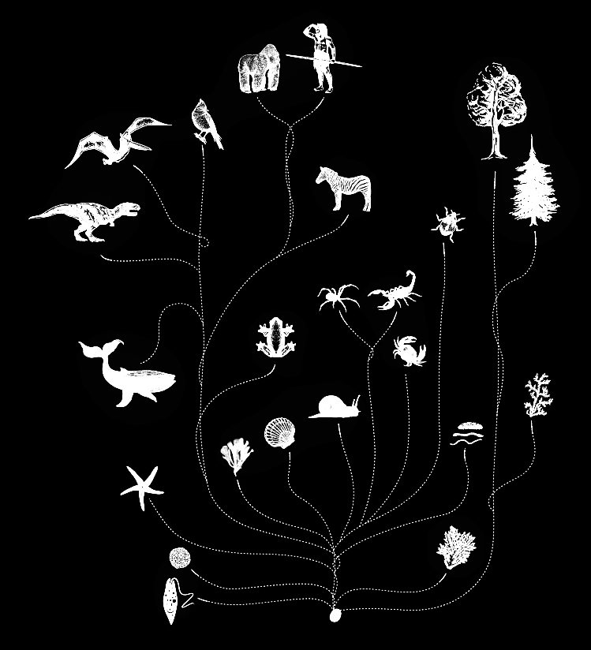
Darwin said that all species including humans were not created independently but they descended from a common ancestor from then life on the planet began to diversify.
Cultural evolutionary theorists have argued that, in a process roughly analogous to genetic evolution, selective pressures made certain cultural beliefs more likely to survive and spread than others.
Beliefs in omniscient supernatural watchers capable of doling out punishments and rewards helped solve this problem by deterring free riding, giving groups adopting these beliefs an advantage over other groups.
THE IMAGE OF GOD
A RESEARCH PAPER IDENTIFYING AND DETAILING
THE FORM, CONTENT AND FUNCTION OF
THE IMAGE OF GOD IN WHICH
MAN WAS MADE.
F16 TH201: BIBLICAL DOCTRINES
BY
THOMAS ALBERT KILIAN III
ELIZABETH CITY, NORTH CAROLINA
DECEMBER 8, 2016

Slide 14
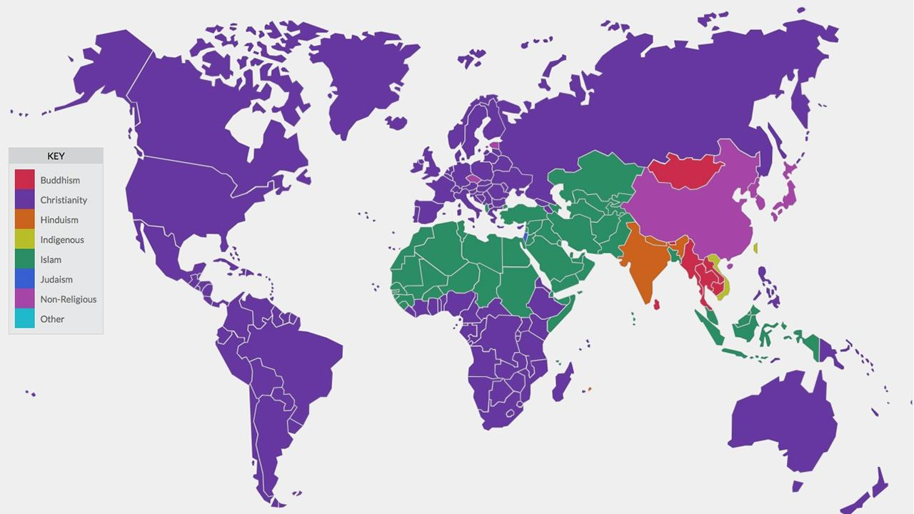
GODS (That is where religion comes in)
Beyond the myths and rituals, the temples and cathedrals, the dos and don'ts that have, for millennia, separated humanity into different and often competing camps of belief.
Religion is little more than a "language" made up of symbols and metaphors that allows believers to communicate, to one another and to themselves, the ineffable experience of faith.
It's just that, though there has been one symbol that has stood out as a universal and supreme-one grand metaphor for God from which practically every other symbol and metaphor in nearly all the world's religions have been derived.
Collection: Sacred Journeys with Bruce Feiler

Slide 15
Human Origin before the “Theory Of Evolution”
The origin of Earth, human beings and other species before the “theory of Evolution” by Charles Darwin was believed to have took place in a different manner and is still believed by a major portion of the society. People belonging to different cultural groups, that is people believing in different gods were and still believe in a theory of human evolution taught to them which has been passed through ages via different means of stories, rituals and holy books they tend to follow and worship.
People following the the largest religion in the world named Christianity believe in the creation story of God and the first humans, Adam and Eve, as mentioned in the Holy Bible, a very similar story yet with vast differences, people with Islamic beliefs believe in the story of Âdam or Aadam (Arabic: آدم‎) who is believed to have been the first human and nabi on Earth. Adam's role as the father of the human race is looked upon by Muslims with reverence. Muslims also refer to his wife, Haawa (Arabic: حَـواء‎, Eve), as the "mother of mankind".
Hinduism whereas has a totally different creation story of humankind on earth and as we go deep we find that hinduism describes more than one creation story of existence of life on earth.

Slide 16

Christianity
Christianity is an Abrahamic monotheistic religion based on the life and teachings of Jesus of Nazareth. Its adherents, known as Christians, believe that Jesus is the Christ, whose coming as the messiah was prophesied in the Hebrew Bible, called the Old Testament in Christianity, and chronicled in the New Testament. It is the world's largest religion with about 2.4 billion followers.
The vast group of people who follow Christianity believe in the story of Adam and Eve as the origin of human life on earth as described in The Holy Bible.
According to Bible, God, the creator of everything from nothingness, he created water, vegetation, day and night and then created the first man Adam and from a bone from the rib of Adam created the first woman Eve. Adam and Eve were allowed to live in heaven and enjoy the all the leisures just not to touch and eat from the forbidden tree of knowledge. As time passed and due to the basic traits of human beings Adam and Eve forgot about this command of God. The devil also created by God in form of a serpent manipulated Eve to eat that apple and Adam and Eve both ate from that tree. When God came to know about this mistake of Adam and Eve, he asked them to descend from the Garden of Eden to Earth as a punishment when Adam reasoned with God about placing the apple and Eve in his life.
This story has been a part of the Bible and has been described in the first three chapters of it.
To understand the story of human origin we will go on which line to line text analysis of the first three chapters of The holy Bible in the coming slides.

Slide 17

Islam
Islam is an Abrahamic monotheistic religion teaching that there is only one God (Allah), and that Muhammad is a messenger of God. It is the world's second-largest religion with over 1.8 billion followers or 24.1% of the world's population, known as Muslims. Muslims make up a majority of the population in 49 countries.Islam teaches that God is merciful, all-powerful, and unique, and has guided mankind through prophets, revealed scriptures and natural signs. The primary scriptures of Islam are the Quran, believed to be the verbatim word of God, and the teachings and normative examples (called the sunnah, composed of accounts called hadith) of Muhammad (c. 570 – 8 June 632 CE).
It is believed that The Holy Quran descended to this world after Christianity and mentions some of the corrections from the The Holy Bible.
The group of people believing in the the God with no image that is the religion which does not believe in the non-humanoid God ‘Allah’, follow a the story of nabi Aadam and Mother Haawa as the origin of humankind as described in The Holy Quran.
The Holy Quran describes a very similar story of human origin yet with some differences. Other than the names of the first humans(asked the angels in his service to get sand from different areas of earth. He then used that sand to create the first man), The holy Quran mentions ‘Iblish’ the devil who manipulated Aadam and Haawa to eat the fruit of the forbidden tree, also The Holy Quran marks that eating the fruit was a mistake committed by both Aadam and Haawa not just Haawa like it is mentioned in The Holy Bible.
The Quran also describes the lives on earth as a punishment for humankind until the day of Resurrection.
The Holy Quran is a book containing different stories of how one should go on with things in his day to day life and until death. In the following slides will do a line to line analysis of parts mentioned in The Holy Quran to understand the origin story better.

Slide 18

Hinduism
Hinduism is an Indian religion and dharma, or way of life, widely practised in the Indian subcontinent and parts of Southeast Asia. Hinduism has been called the oldest religion in the world, and some practitioners and scholars refer to it as Sanātana Dharma, "the eternal tradition", or the "eternal way", beyond human history. Scholars regard Hinduism as a fusion or synthesis of various Indian cultures and traditions, with diverse roots and no founder. This "Hindu synthesis" started to develop between 500 BCE and 300 CE, after the end of the Vedic period (1500 to 500 BCE), and flourished in the medieval period, with the decline of Buddhism in India.
Although Hinduism contains a broad range of philosophies, it is linked by shared concepts, recognisable rituals, cosmology, shared textual resources, and pilgrimage to sacred sites. Hindu texts are classified into Śruti ("heard") and Smṛti ("remembered"). These texts discuss theology, philosophy, mythology, Vedic yajna, Yoga, agamic rituals, and temple building, among other topics.Major scriptures include the Vedas and the Upanishads, the Puranas, the Mahabharata, the Ramayana, and the Āgamas. Sources of authority and eternal truths in its texts play an important role, but there is also a strong Hindu tradition of questioning authority in order to deepen the understanding of these truths and to further develop the tradition

Slide 19
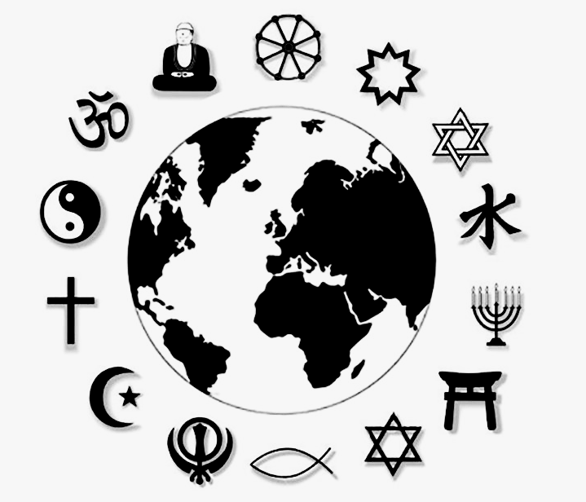
Which one is true
We only saw a few different ways human origin has been explained and we ended up with handful of different ideas how this world and human beings came into existence.
The world has 4200 religions and majority of these has multiple texts about the beginning of the world, thousands of scientific theories and more than a billion other books which talks about the story of origin in their own way.
How can someone decide which of these is true or which one of these he should be following?
4200 religions
According to some estimates,there are roughly 4200 religions in the world. out of which CHRISTIANITY is the world's largest religion which is followed by ISLAM.

Slide 20
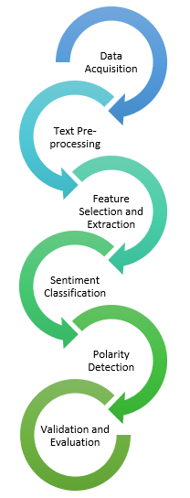
Sentiment Analysis : a decisive tool
Sentiment analysis is a powerful tool to analyse text and classify it on different grounds on the basis of emotions and tones of each word in a sentence to each sentence of a paragraph , paragraphs of pages and so on. Sentiment analysis models are either trained with already analysed texts or defined with algorithms to classify phrases.
A better way to look at what might be the truth behind human origin and the world or maybe looking at an unbiased and thoroughly analysed result of all the theories, stories etc and decide what one should believe and to have a better understanding of why the things are the way they are now.

Slide 21
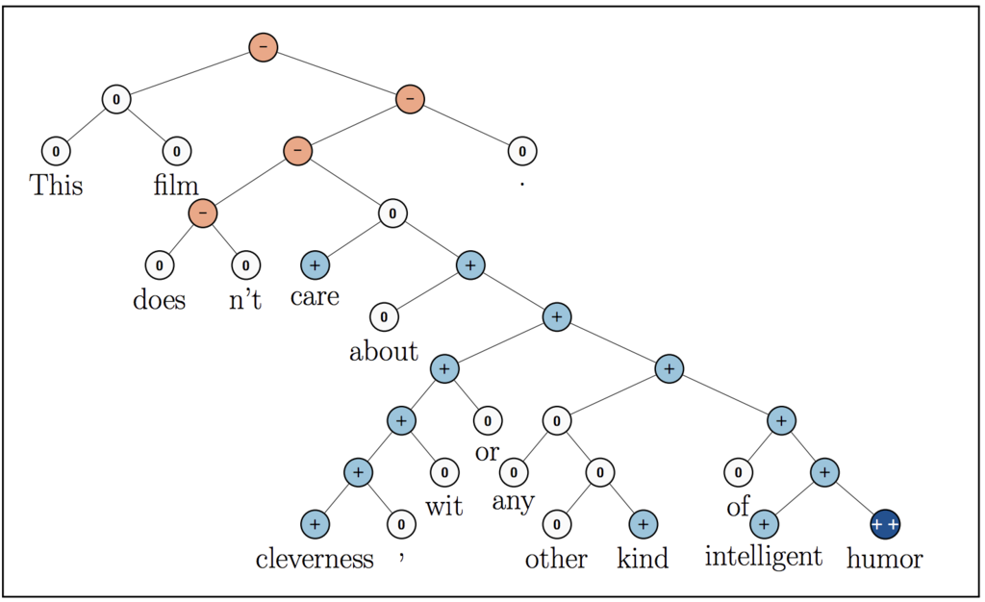
How text is analysed
The text input is divided into sentences and further into words. Each word act as a token and the algorithm assigns a value between -1 and 1 based on positivity or negativity of it. On the sentence level the algorithm analyses the structure and arrangement of the words and defines values for different emotions.
For example in the figure the latter part of the sentence has positive values but because of presence of the ‘doesn’t’ the sentence turns of to be of negative emotion

Slide 22
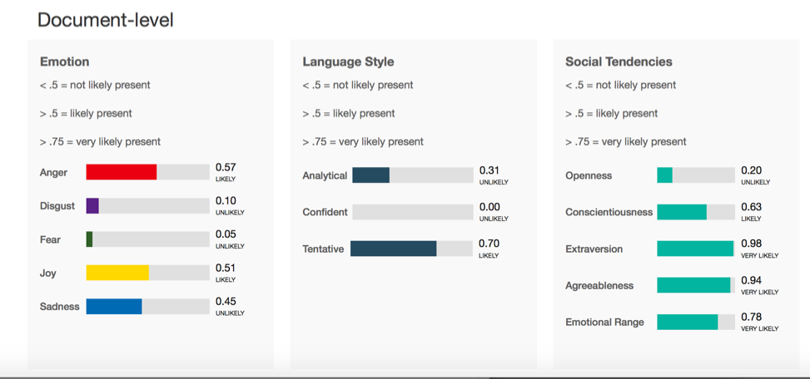
IBM WATSON:
The IBM Watson™ Tone Analyzer service uses linguistic analysis to detect emotional and language tones in written text. It works on the principle of Natural Language Processing (NLP) in which the model was trained for more than 26 months using texts from different areas like comments on social media, conversations over reality shows and news channels and many other textual and audio based sentences. The IBM Watson Tone Analyser gives a score between 0 and 1 of different emotions like anger which can be read as the percentage of the particular emotion present in the text. It also analysis the language style used and social tendencies of the text.

Slide 23
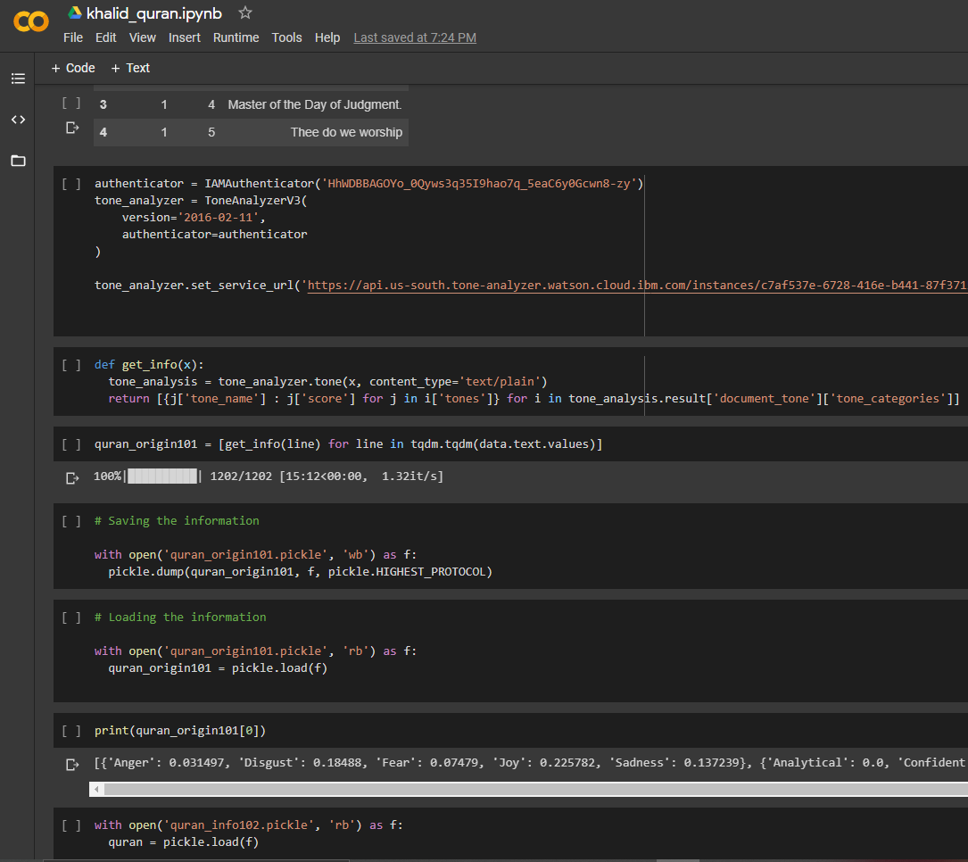
Working:
The IBM Watson™ Tone Analyzer service provides free API which can be implemented with different languages one of them being python. The API service allows 2500 API calls per month free but charges exceeding this limit. Each API call takes the input text from the database we prepared sends it to the IBM WATSON service provides and the result is sent back to the code which can be pickled. To analyse some religious texts, scientific journals and novels we made at least 13,000 API calls i.e we analysed 13,000 lines from different sources which we added to our database.

Slide 24

Information Visualization
Information Visualization is a practice of visualising abstract data i.e visualizing data which does not have a natural representation to amplify cognition.
We converted pickle file of emotions from IBM watson into a .csv file with values of emotions, number of lines and the source which the lines was taken from in order to plot graphs between different combinations of emotions and sources to observe similarities and differences and to draw results.
Tableau, a very famous interactive software which can be used to visualize information on user defined rules.

Slide 25
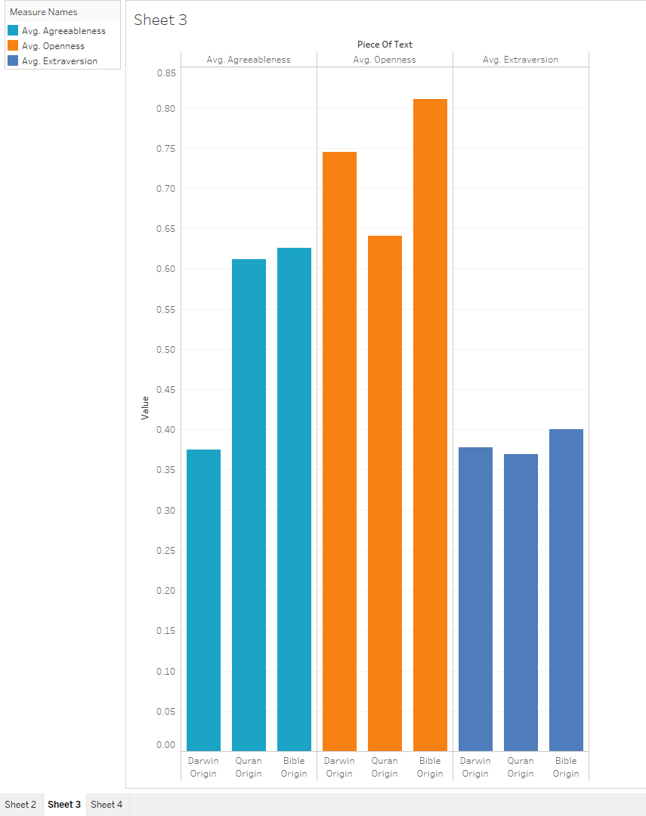
Plot - 1 The Origin Story
Using the origin story of The HOLY BIBLE, THE HOLY QURAN and Charles Darwin Theory Of Evolution
According to a survey only 0.27% of the world population considers themselves as atheist.
As we can see the agreeableness of the Scientific texts is the lowest whereas as the agreeableness of Bible is the highest which proves why a major portion of the world population follow Christianity in turn GOD and a very few people knows the side other than GOD.
The Extroversion of all the three texts is approximately same which states that the things which are explained in the texts but it is the high values of openness and agreeableness which makes it easier for humans to believe in the existence of GOD as the story sounds more believable and relatable to their lives.

Slide 26
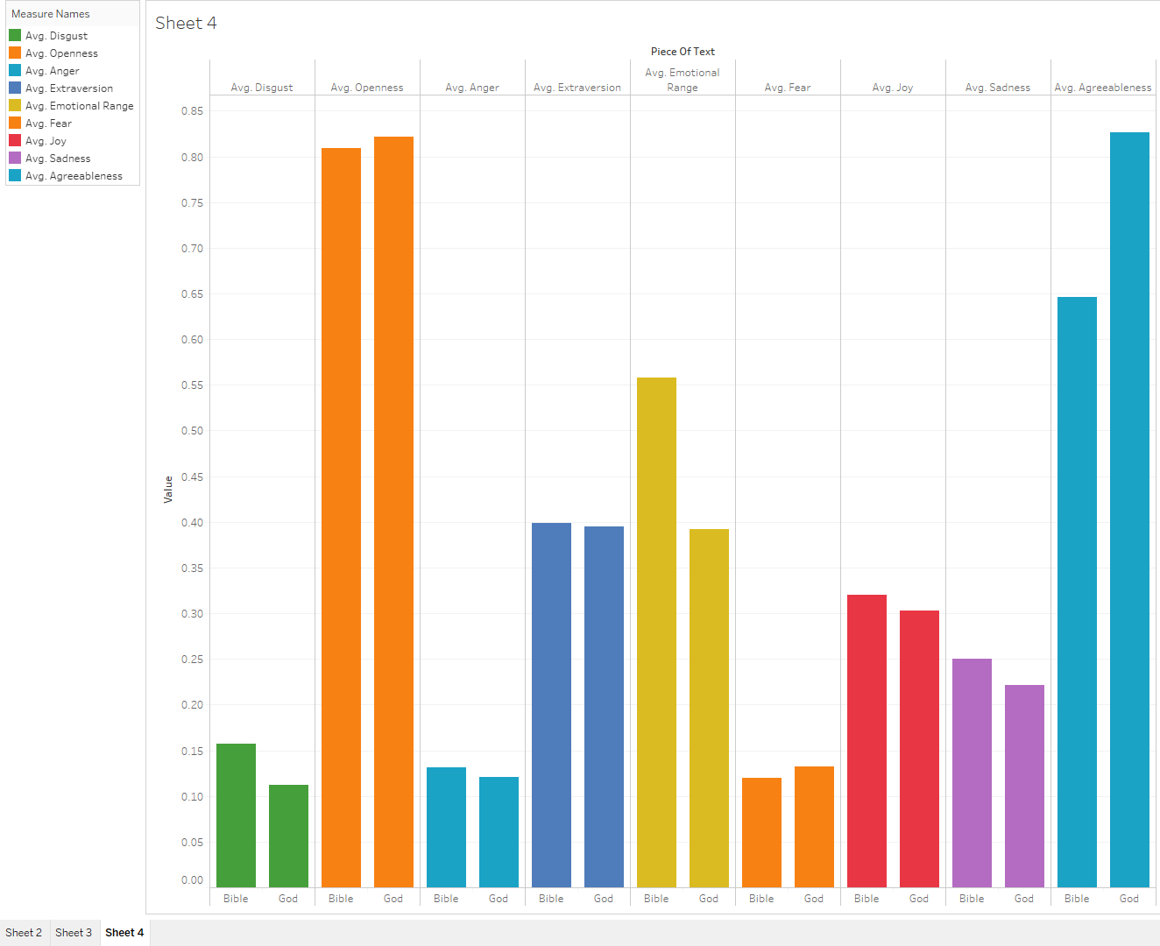
Plot - 2 God v/s a Storyteller
Using The HOLY BIBLE and the novel GOD : A human History by Reza Aslan
God : a Human History , this book by Reza Aslan narrates and describes the story as mentioned in the Holy Bible.
The graph shows higher values of anger, disgust and sadness the negative emotions in the Bible.
Openness of the novel is slightly higher than openness of the Holy Bible but the agreeableness values have huge differences.

Slide 27
Plot 2 - God v/s a storyteller Results
We previously saw that the scientific theory of origin stated facts still its agreeableness values were very low in comparison to religious texts like THE HOLY BIBLE and THE HOLY QURAN which projected the origin story in form of stories.
When a writer from the same era we belong to, describes the origin story in THE HOLY BIBLE using the same facts and figures science gave years back but in a language easily understood by an average human being the agreeableness and openness increases drastically.
It is believed that the religious texts ( specially in Islam and Christianity ) are narrations of God while the book by Reza Aslan is written by a human being still both have very comparable values for human emotions like joy, anger , sadness etc. which somewhere proves REZA’s concept of humanoid god true i.e we created someone called GOD in our own image, with all our emotions with just some supernatural attributes and more powerful than us.
The average emotional range of the book by Reza Aslan has lower values than The HOLY Bible as the book describes the story in a more factual way whereas the texts of the religious books are more towards a dramatic side.

Slide 28
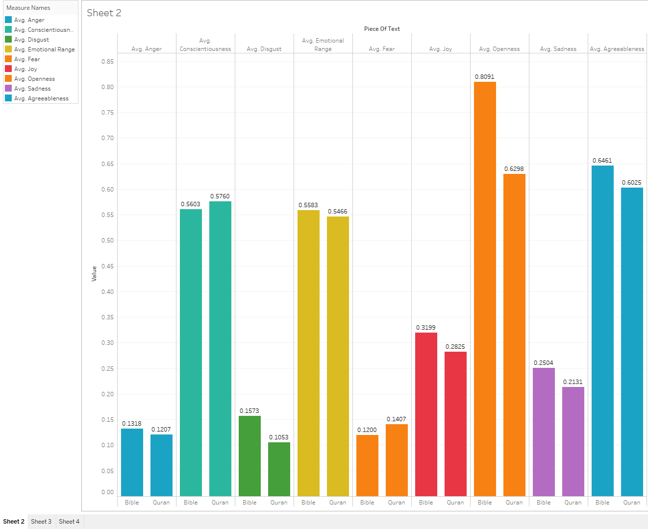
Plot 3: Christianity and Islam
Using The holy Bible and The Holy Quran
One can see that the values of almost all categories like emotional factors, language style and social tendencies have values nearly equal i.e very comparable for both the texts, THE HOLY QURAN and THE HOLY BIBLE according to which both these texts should have similar effects on human minds but the case is not same with people belonging to these groups. People following these particular religions have very different habits and perspective towards the notion of GOD.
This is because we have used average values in this plot and the aggregation step sometimes hinder some results because of differences in the length of the books.

Slide 29
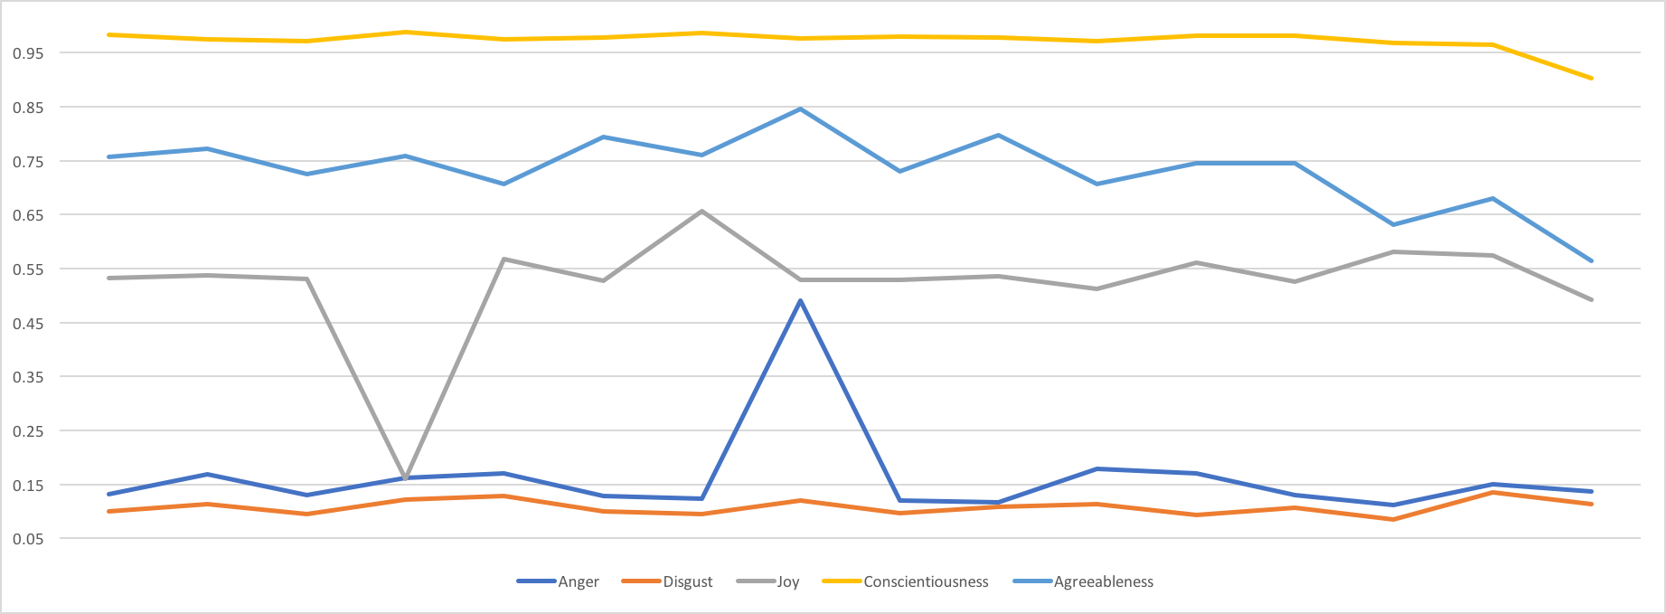
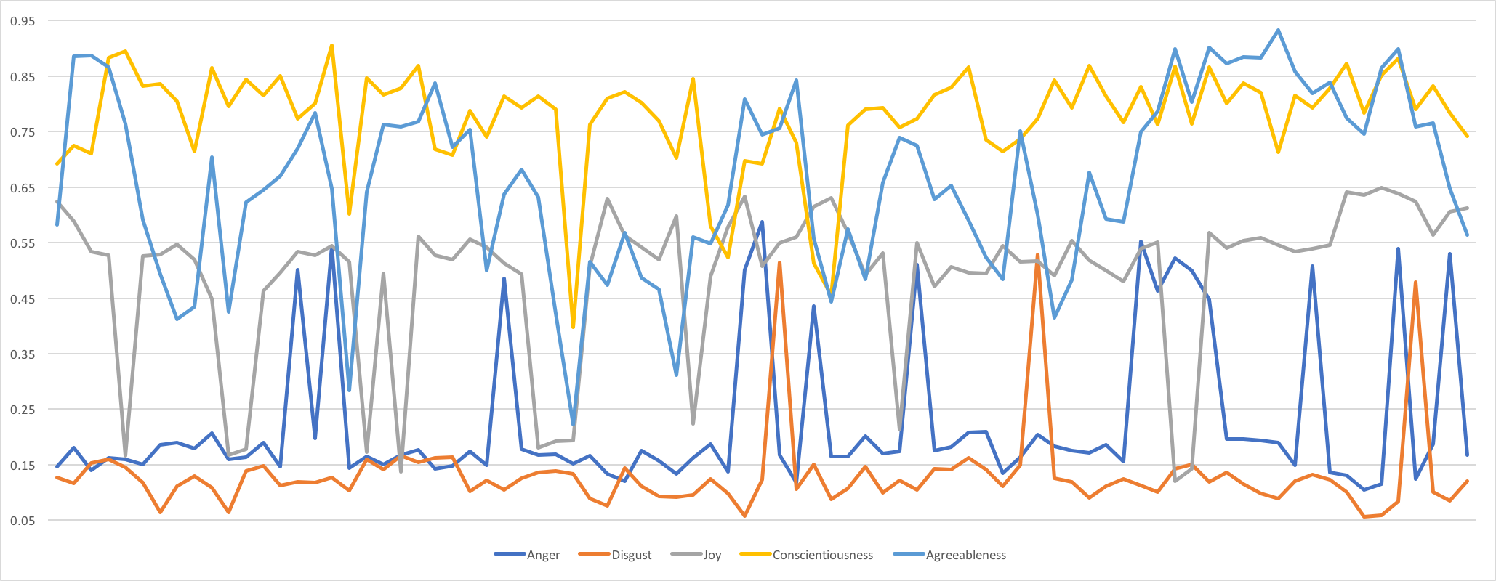
How Sentiments change over the course of Quran and Bible
When values are averaged we see comparable values but when we see how emotions vary over the course of the books we find that The Holy Quran is more stable with respect to these emotions while for The Holy BIBLE huge variations in the emotion line is seen.
While the Quran is lowest in expressions of anger, disgust and highest in joy, agreeableness and conscientiousness, these results are far from the societal view of the religion islam.
Quran
Bible

Slide 30
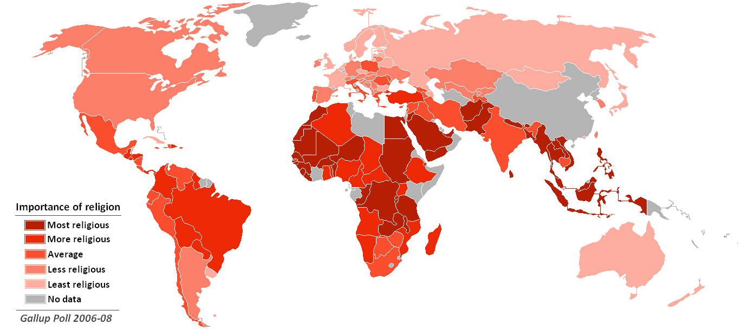
Present Findings:
The Origin:
We saw that science tries to answers questions about what happened using facts and figures whereas religion proposes a story of why things happened.
From the graphs we plotted we can see that because of very high agreeableness values of way things are explained in religious texts might be the reason behind why a very huge fraction of human population believes that the world and all living things on it were created in one day by God and is not a result of evolution which took hundreds of years.

Slide 31
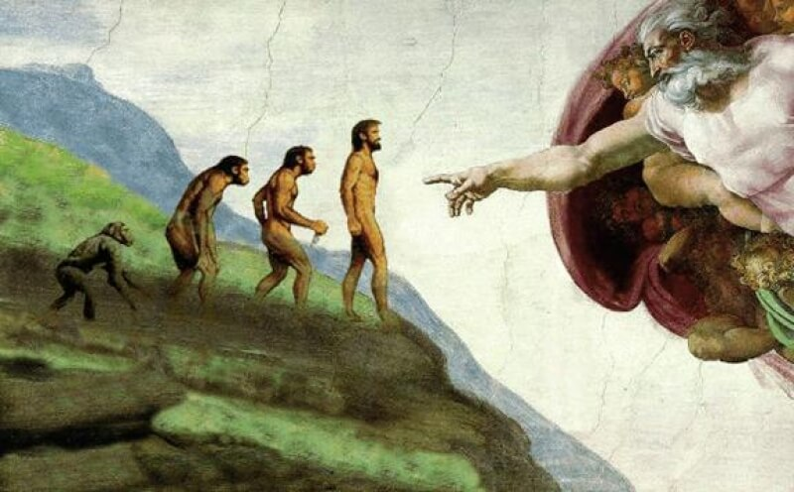
Present Findings:
“Religion follows science, the survival of the fittest” “Not only people, gods die too”
From the literature analysis we infer that belonging to a group with a certain set of rules and beliefs make it easier for people to survive problems and gives them a sense of safety in the society. Some groups became powerful over time than other groups which led to extinction of the groups with less number or power. The religions we see today are the groups which grew with time and survived and maybe not created different by god or by different gods.
As per the conclusion we cannot say that what happened hundreds of years ago but looking at structure of both Divinity and Science we can say that both these things coexist together for this society to function acting like two sides of coin and everyone has the right to choose their side.

Slide 32
Present Findings:
“Songs are as sad as the listener.” ― Jonathan Safran Foer
When something is transferred from on being to another, it is the human tendency to change that conversation unintentionally a bit.
According to the religious texts, every religious texts can be categorised as ‘heard’ or ‘ remembered’ i.e those texts were written on basis of things which were communicated over the course of time. If we assume that communication between two people can change the conversation even by 0.00000000001 %, and we know that these beliefs have been passed on from generation and we cannot say how much truth is there on what we know today.
From the graphical analysis we saw that according to the textual analysis THE HOLY QURAN has very less values for for emotions like, disgust , anger etc when compared to THE HOLY BIBLE and maybe other religions but the concept of terrorism which is said to have emerged out of islam shows totally opposite emotions. This is just one example of hundreds of differences between what a religion asks you to do and what people do.

Slide 33
References
Bible in King James Version.book: Genesis: https://www.kaggle.com/phyred23/bibleverses
The Holy Quran English (Translation by Yusuf Ali) https://www.kaggle.com/zusmani/the-holy-quran
God: A Human History , Reza Aslan http://libgen.li/item/index.php?md5=F50C7E134F66EE445BFE52EC72E2F38B
Theory Of Evolution by Charles Darwin (speaker notes) https://www.sparknotes.com/lit/origin/summary/
Belief in God: Why People Believe,and Why They Don’t Brett Mercier, Stephanie R. Kramer, and Azim F. Shariff https://www.researchgate.net/publication/321887719_The_Belief_in_God_Why_People_Believe_and_Why_They_Don't
An Essay on the Principle of Population, Thomas Robert Malthus http://www.esp.org/books/malthus/population/malthus.pdf
THE IMAGE OF GOD.F16 TH201: BIBLICAL DOCTRINES BY THOMAS ALBERT KILIAN III ELIZABETH CITY, NORTH CAROLINA DECEMBER 8, 2016 https://www.researchgate.net/publication/313870470_THE_IMAGE_OF_GOD_A_RESEARCH_PAPER_IDENTIFYING_AND_DETAILING_THE_FORM_CONTENT_AND_FUNCTION_OF_THE_IMAGE_OF_GOD_IN_WHICH_MAN_WAS_MADE#:~:text=full%2Dtext%20PDF-,THE%20IMAGE%20OF%20GOD%3A%20A%20RESEARCH%20PAPER%20IDENTIFYING%20AND%20DETAILING,IN%20WHICH%20MAN%20WAS%20MADE.&text=What%20is%20man%3F&text=1%20Throughout%20history%20mankind%20has,man%20in%20his%20own%20image.
BCC https://www.bbc.co.uk/teach/charles-darwin-evolution-and-the-story-of-our-species/z7rvxyc

Slide 34
Thankyou

